Slide 1
Journeysmith: The Future of Worldbuilding
Team Members: Luke de Vries, Noro Dung, William Elsen, Saron Melesse, Nathan Schultz, Chase Velloney

Slide 2
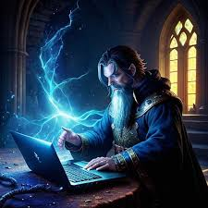
Vision
Easy information storage for DMs
Flexible framework for information
Free
Simple UI
Notes:
Talk about how competitors are either overly complicated or locked behind a paywall or both. We want to make a free, easy, powerful tool.

Slide 3
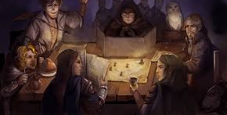
Demonstration
Notes:
Have Chase run a virtual campaign, Nathan runs a pen and paper campaign

Slide 4
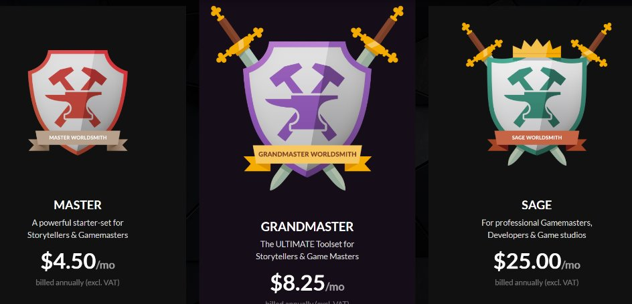
Why Journeysmith?
“…every time i open the page i spend about an hour trying to get something, anything done only to close it in defeat” (Regarding WorldAnvil) –Samandirie

Slide 5

Database Format
Dungeon Master(ID, nickname, loginID, password)
Map(ID, DungeonMasterID, MapImage, MapName, supermapID)
Note(ID, WorldMapID, Content)
Pin (ID, NoteID, x, y, color, icon)

Slide 6
Deployment Model
<<Client>>
Operating System
Expo
Journey Smith
REST
<<Data Services>>
<<Web Services>>
PostgreSQL for Azure
Azure Web-service
Web-server
PostgreSQL
<<Github>>
Web-service repository

Slide 7
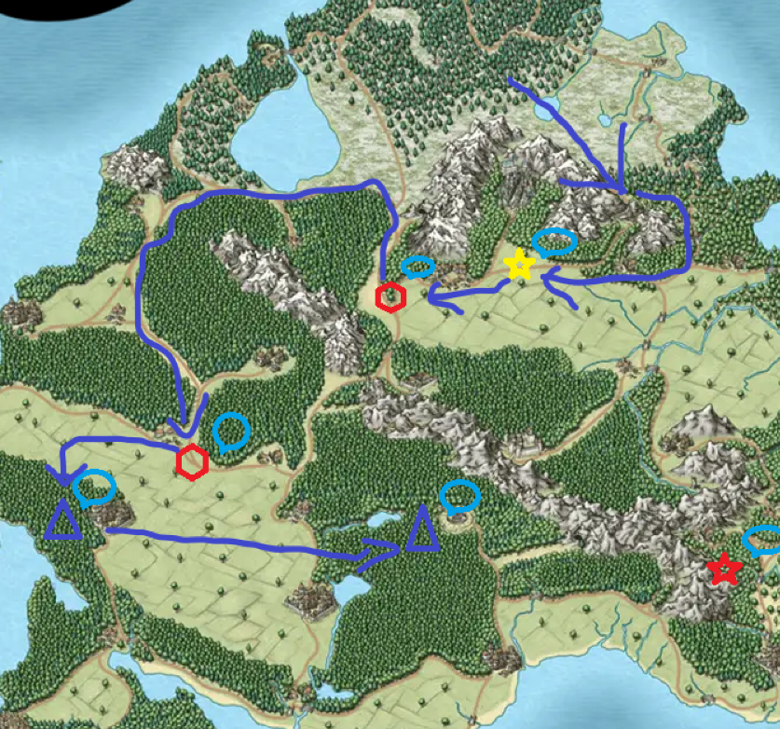
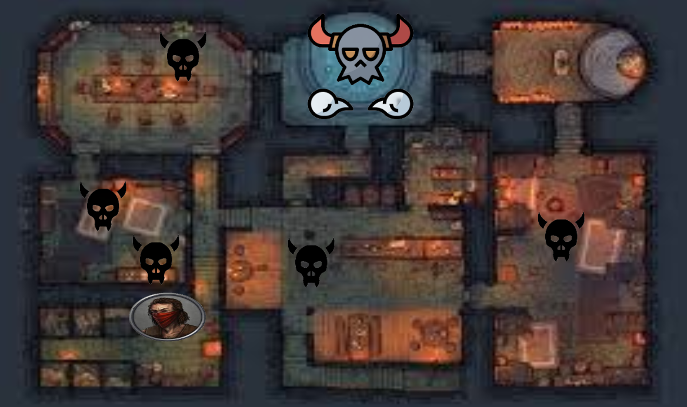
Features in Progress
Sub-maps
Custom pins
Draw tool
Fonts and styles for notes
Text labels

Slide 8


Usability Testing results
Enlarged pin icons
Differentiated notes boxes
Added cancel pin placement button
Fixed inconsistent spacing of
campaigns and add campaign button

Slide 9

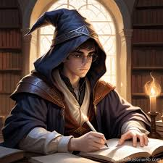
Ethics of Journeysmith
Players miss out on Journeysmith(Neil Postman’s Second Law)
Loss of spontaneity(Neil Postman’s first and third laws)

Slide 10
Questions?

